Slide 1
Memory Lane
I love my Grandad very much
His stories make me smile
But those stories that he used to tell
He hasn’t told them for a while.
He loved to go down ‘Memory Lane’
He’d sit me on his lap
He’d tell me tales of long ago
When he was a ‘handsome chap’.
Of when he joined the navy
And when he met my nan
Of goals he scored and cars he raced
And the marathon he ran.
Of when he learned to cycle
And his first time in a plane
My Grandad talked for hours
When he went down ‘Memory Lane’.
But ‘Memory Lane’ is closed now
My Grandad’s not the same
And sometimes when I visit him
He doesn’t know my name.
They say it is ‘dementia’
And it’s affecting Grandad’s brain
But I’ll always love my Grandad
And our trips down ‘Memory Lane’.
planetpoetry ® 2012©

Slide 2
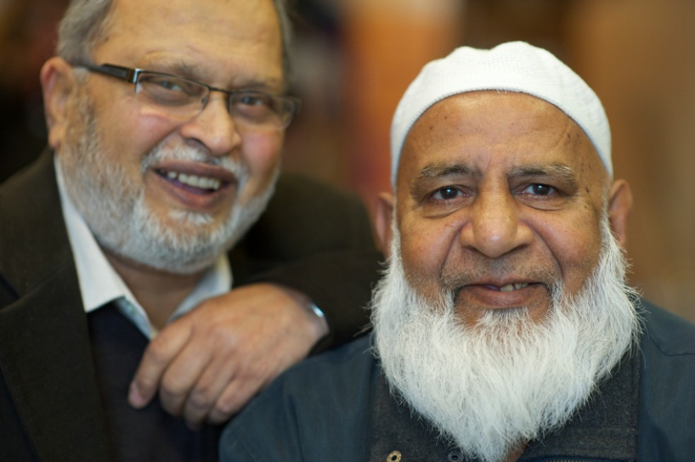
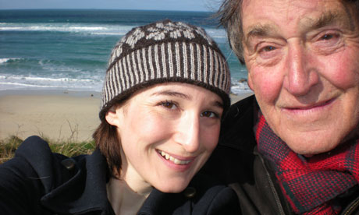
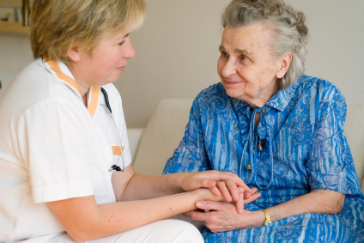
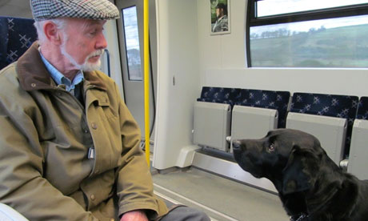
Meeting those working and living with dementia

Slide 3
Learning objectives
To be able to empathise with those with dementia and their carers
To appreciate that a diagnosis of dementia is not the end of the battle
To know how carers are supported and what can be done to help those with dementia and the support available for a carer

Slide 4
The Visit
In this lesson you and will have the opportunity to meet and talk with three people: a person with dementia, a carer and a person who works with those living with dementia.
They will be brought to the classroom by your two dementia champions
Remember that they will be unfamiliar with the school surroundings and are likely to be nervous. You all need to be at your best to make them feel at ease.
Remember the lesson objectives and the suggested questions but don’t be afraid to ask other questions.

Slide 5
How should I behave around someone with dementia?
Make a good first impression – smile, show interest, say who you are when talking to them.
Be conscious of non verbal communication (as language fails a person, they will look for non-verbal clues. The person can get a message from your tone, volume of voice, posture, hand gestures).
Help people feel valued for who they were in the past, as well as who they are in the present.
Make sure that you listen and show that you are listening and are interested.
Be courteous – don’t talk down or criticise them. Don’t talk as if they’re not there
Respect a person’s cultural values – such as religion, what they can eat, whether to address them formally or informally.
UNDERSTAND HOW THE PERSON FEELS, AND TREAT THEM AS YOU WOULD WANT TO BE TREATED YOURSELF

Slide 6
And finally….
What have you learnt?
How do you feel?
How will you change?

